Slide 1
Embedded System Design
Project Overview
Igor Janjic
Leah Krynitsky
Brian Hilnbrand
Danny Duangphachanh

Slide 2
Component Communication
External or hard-wired connection
Internal connection
Wireless connection
Train bus connection
¹ System layout shown on next slide
² Quadrature Encoder
ARM System¹
Accelerometer
(LSM303D)
I²C
(slave)
Sensors
(GP2Y0A60SZLF)
WiFly
UART
I²C2
(master)
Q.E.²
(Left)
Q.E.² (Right)
Rover Master PIC
(PIC18F46J50)
AN0 - AN8
Sabertooth Motor Controller
Motor PIC
(PIC18F45J10)
Sensor PIC
(PIC18F45J10)
I²C
(slave)
I²C
(slave)
Timer
I²C
(master)

Slide 3
Component Communication Cont.
Rover System¹
WiFly
WiFly
Push Buttons
UART
ARM Board
switch between tabs
LEDs
LCD
External or hard-wired connection
Internal connection
Wireless connection
Train bus connection
¹ System layout shown on next slide
² Quadrature Encoder
ARM PIC
(PIC18F46J50)
process pos data
I²C
(slave)
I²C
(master)

Slide 4
Sensor Selections & Specs
SHARP GP2Y0A60SZLF Analog Distance Sensor
Measuring distance: 10 cm - 150 cm
Recommended operating voltage: 2.7 V - 5.5 V
Operating speed: 60 Hz (16.5 ± 3.7 ms update rate)
Output voltage differential: ~ 3.0 V (3.6 V at 10 cm - 0.6 V at 150 cm)
LSM303D 3-Axis Accelerometer
Supply Voltage: 2.16 V - 3.6 V
I²C interface
Operating speed: Anywhere from 0 kHz - 400 kHz
16-bit data output

Slide 5
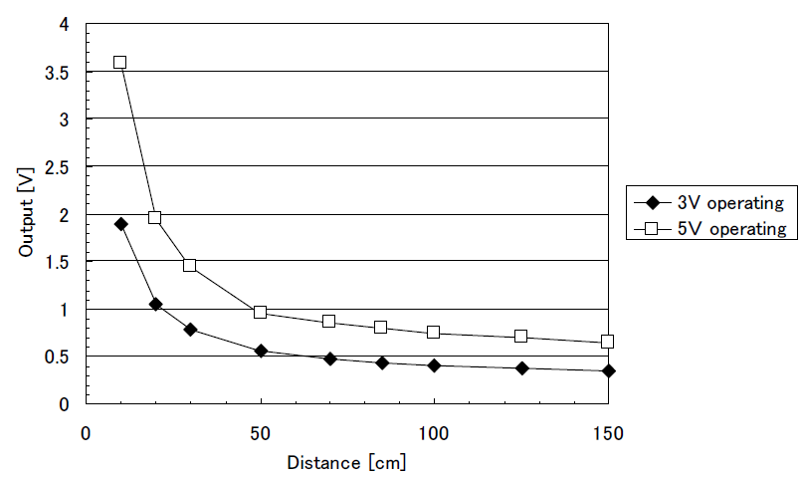
Sensor Analog Output vs. Distance
*Graph found in datasheet available at: http://www.pololu.com/file/0J812/gp2y0a60szxf_e.pdf

Slide 6
Sensor Locations on Rover
Two IR sensors on each side of the rover for:
Object/obstacle detection
Direction calibration
General Orientation of Rover
Two additional IR sensors on front side (center) spaced vertically for ramp detection
One accelerometer on rover to detect rover tilt (flat surface or on ramp)

Slide 7
Sensor Communication
IR Sensors hard wired to analog inputs of Sensor PIC (PIC18F45J10)
Analog data from IR sensors converted using Sensor PIC A/D module
Accelerometer connected via train bus to I²C2
Requests for data received via I²C from Rover Master PIC (PIC18F46J50)
10-bit digital results from IR sensors and 16-bit results from accelerometer sent to Rover Master PIC via I²C
Data relayed to ARM PIC (PIC18F46J50) via WiFly and sent to ARM Board via I²C

Slide 8
ARM Communication Overview
ARM and 45J50 PIC (address 0x4F) communicate via I²C
Sensor queries sent to PIC 0x4F
Sensor data received from PIC 0x4F
Sensor data processed
Sensor data displayed
Rover and/or ramp locations determined
Motor commands generated
Motor commands sent to PIC 0x4F

Slide 9
ARM Tasks
I²C Monitor
Commander
IR0 Timer
Locate
IR00
DataConductor
.
.
.
Conductor
AC0
AC0 Timer
LCD Timer
LCD

Slide 10
ARM Communication
Sensor Data Protocol
Sensor queries are sent to PIC 0x4F via I²C
Query rate is set as a compile time parameter
For each query if no data is available, PIC 0x4F will reply with 0x00
Received sensor data is preprocessed in various threads depending on which sensor the data corresponds to
IR Sensors:
IR threads receive 2 bytes where the first byte is the first 8 bits of the sensor data and the last byte is the last 2 bits of the IR0 data
IR0 sensor located on the front of the rover spaced vertically
IR00 thread sends 0x0A to begin a query for data
IR01 thread sends 0x0B to begin a query for data
IR1 sensor located on the front of the rover spaced horizontally
IR10 thread sends 0x1A to begin a query for data
IR11 thread sends 0x1B to begin a query for data

Slide 11
ARM Communication
Sensor Data Protocol (Cont)
IR Sensors:
IR threads receive 2 bytes where the first byte is the first 8 bits of the sensor data and the last byte is the last 2 bits of the IR0 data
IR2 sensor located on the right of the rover spaced horizontally
IR20 thread sends 0x2A to begin a query for data
IR21 thread sends 0x2B to begin a query for data
IR3 sensor located at the back of the rover spaced horizontally
IR30 thread sends 0x3A to begin a query for data
IR31 thread sends 0x3B to begin a query for data
IR4 sensor located on the left of the rover spaced horizontally
IR40 thread sends 0x4A to begin a query for data
IR41 thread sends 0x4B to begin a query for data
AC0 thread sends 0x5A to begin a query for data from accelerometer sensor 0
AC0 thread receives 6 bytes (2 for each axis) in 2s compliment form

Slide 12
ARM Communication
Motor Command Protocol
Motor commands sent to PIC 0x4F via I²C
Commander thread sends 1 byte representing the command that the motor controller will execute and 1 byte representing the speed the command will be executed at
Then a query byte is sent that details whether or not the rover has hit an obstacle: 0x41:
No obstacle encountered: 0x00
Obstacle encountered: 0x01
Commands are separated into two groups depending on the distance granularity needed: fine and coarse
Fine commands:
Rotate left by 5 degrees: 0x11
Rotate right by 5 degrees: 0x12
Move forward 1 centimeters: 0x13
Move backward 1 centimeters: 0x13
Coarse commands
Rotate left by 45 degrees: 0x21
Rotate right by 45 degrees: 0x22
Move forward 5 centimeters: 0x23
Move backward 5 centimeters: 0x24
Speed:
Execute command at a slow rate: 0x31
Execute command at a medium rate: 0x32
Execute command at a fast rate: 0x33

Slide 13
ARM Algorithms
Motor Command
Relevant object locations and the closest ramp location is sent to the Command thread
Rover has four states:
Roam:
Rover moves until it discovers a ramp or encounters an obstacle
RampDiscover
Rover will periodically rotate 360 degrees to scan for ramps
RampMove
Rover moves toward the ramp
A sequential list of commands that get the rover to the ramp are kept in memory
List is updated with new data and newly discovered objects
RampEscal
Rover aligns with the ramp and goes over it

Slide 14
ARM Algorithms
Data Integration and Routing
After incoming sensor data is received, it is sent to the DataConductor thread which further processes the data, integrates it, and routes it to the Locate thread, LCD thread, and Commander thread
Routes data at a rate determined by compile time parameters
Sends processed data to the LCD thread which displays it on appropriate tabs on the display
Sends processed IR sensor data to Locate thread
Sends processed AC sensor data to Commander thread
Integration algorithms:
Filtering outliers
Converts IR sensor voltages to distances
Converts AC sensor voltages to angles

Slide 15
ARM Algorithms
Rover Localization
After incoming IR sensor data is processed it is sent to the Locate thread which locates the rover on the internally supplied map, locates nearby ramps, and sends this data to the LCD
Only data about relevant objects are sent to Commander thread
Rover localization:
If an object is encountered it is appended to a list of currently known about objects
Distances to the object and counterclockwise angles of the object (with respect to the front of the rover) are kept in memory
List of currently known about objects are updated every time a new data point arrives.
Periodically, the list is scanned and collections of objects representing the same physical thing are integrated
The rover’s location is determined by using this list

Slide 16
ARM Algorithms
Ramp Discovery
Ramp Discovery:
Ramp discovery is performed using data from IR0 sensor
Only nearest ramp data is sent to Commander thread
If a ramp is discovered it is appended to a list of currently known about ramps
Distances to the ramp and counterclockwise angles of the ramp (with respect to the front of the rover) are kept in memory
List of currently known about ramps are updated every time a new data point arrives from the DataConductor thread

Slide 17
ARM Algorithms
Displaying Data
DataConductor thread sends processed data to appropriate tabs on the LCD
Tabs can be toggled with the pushbutton (or maybe by swiping the touch screen)
TAB0 displays the IR0 sensors voltages
TAB1 displays the IR1 sensors voltages
TAB2 displays the IR2 sensors voltages
TAB3 displays the IR3 sensors voltages
TAB4 displays the IR4 sensors voltages
TAB5 displays the AC0 sensor voltage
TAB6 displays a list of the distances to and angles from various objects the rover has encountered
TAB7 displays a live map of the rover.

Slide 18
Rover Master PIC Overview
Rover Master PIC communicates with ARM via WiFly and Sensor PIC and Motor PIC via I²C
Receives sensor data request from ARM
Reads sensor data message buffer for sensor data
Transmits sensor data to ARM
Receives motor commands from ARM
Transmits motor commands to Motor PIC

Slide 19
Motor PIC Overview
Motor PIC and Rover Master PIC communicate via I²C
Receives motor commands from ARM via Rover Master PIC
Transmits motor commands as packets to Motor Controller on a single serial line
Receives data from Quadrature Encoders to verify speed and turning angle

Slide 20
Motor Controller Operation
Sabertooth 2x12 Motor Controller
Receives motor command packet from Motor PIC
Will operate in Mode 4: Packetized Serial
One-directional transmission
9600 baud rate
Packet format consists of:
Address byte
Command byte
Data byte
7-bit checksum

Slide 21
Serial Packet Details
Address bytes are assigned by the DIP switch
Will use four possible commands
Drive forward motor 1
Drive backwards motor 1
Drive forward motor 2
Drive backwards motor 2
Data byte will determine the speed the motor will drive
0 will have the motor go into power save mode
127 will have the motor go full power
If checksum is incorrect, the data packet will not be acted upon

Slide 22
Simulation Overview
Why simulate?
Simulation is a key tool for engineers to test parts of products without having the entire product in-hand.
Reduces development cost/time to a fraction of that of real testing.
What does it do?
Mimics communication between component and the rest of the system.
Does not actually emulate the rest of the system does, but generates fake data that could have been produced by the system.
Presents data flow in a human-readable manner.

Slide 23
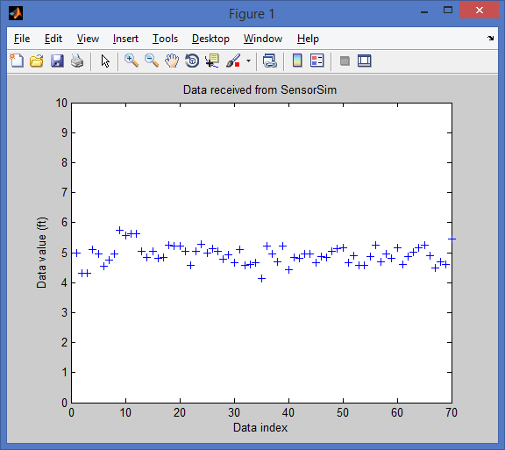
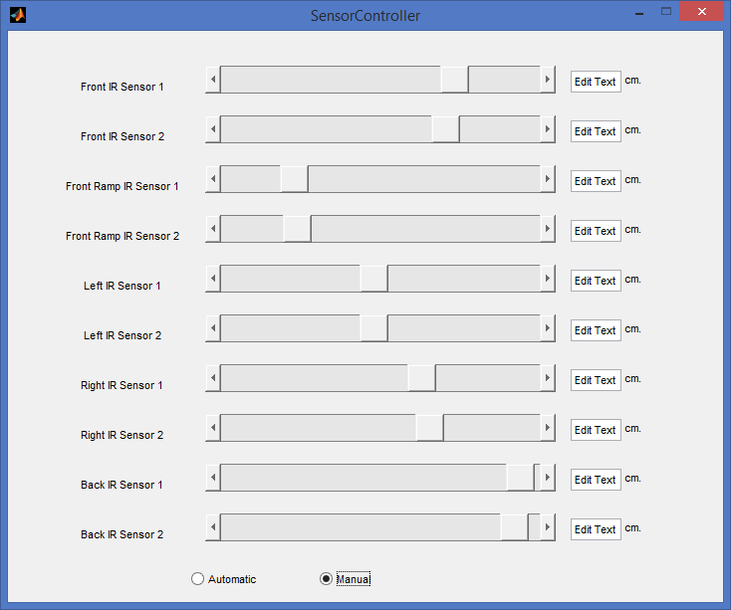
Simulation Overview

Slide 24
Device Communication Protocol
Message Overview
Source Target
Header: “H[Message type][Payload length]”
Handshake: “X[Message Type]”
Payload: “P[Payload]”
Tail: “T”
Handshake: “R[Size of payload received]”

Slide 25
Device Communication Protocol
Message Types
Message Type | ID
MSGT_TIMER0 | 10
MSGT_TIMER1 | 11
MSGT_MAIN1 | 20
MSGT_OVERRUN | 30
MSGT_UART_DATA | 31
MSGT_I2C_DBG | 41
MSGT_I2C_DATA | 40
Message Type | ID
MSGT_I2C_RQST 42 | 42
MSGT_I2C_MASTER_SEND_COMPLETE | 43
MSGT_I2C_MASTER_SEND_FAILED | 44
MSGT_I2C_MASTER_RECV_COMPLETE | 45
MSGT_I2C_MASTER_RECV_FAILED | 46
MSGT_SENSOR_DATA | 50

Slide 26
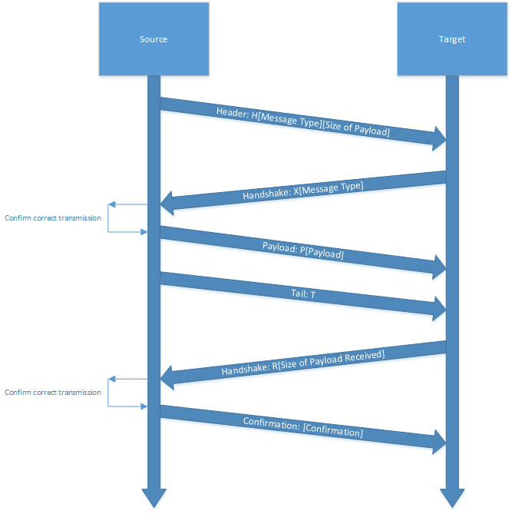
Device Communication Protocol
Message Flow

Slide 27

Questions?
#YOLOSWAG777BEARIT #3BARE4U #NOSCOPE #BEARSBEETSBATTLESTARGALACTICA #EXPLODINGBEAR
Team 7
Rover
Source: http://s3.amazonaws.com/wootdesigncontestentries/2141848/d77b5595-1fbc-4d5e-bcf3-baef36755aa2.jpg

